Slide 1

Whitmore High School
Year 8 Aspire
“Raising Standards at KS3”
Mark Hutton:
Academic Enrichment Manager & Head of Physical Education huttonm6@hwbcymru.net

Slide 2
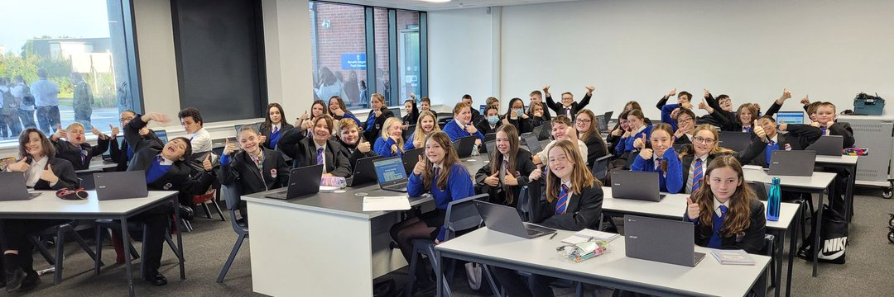

History of Aspire
The Aspire programme was launched in Autumn 2021.
Over 100 pupils from Key Stage 3 participated in 2021/22 and this grew to over 150 pupils during 2022/23.

Slide 3
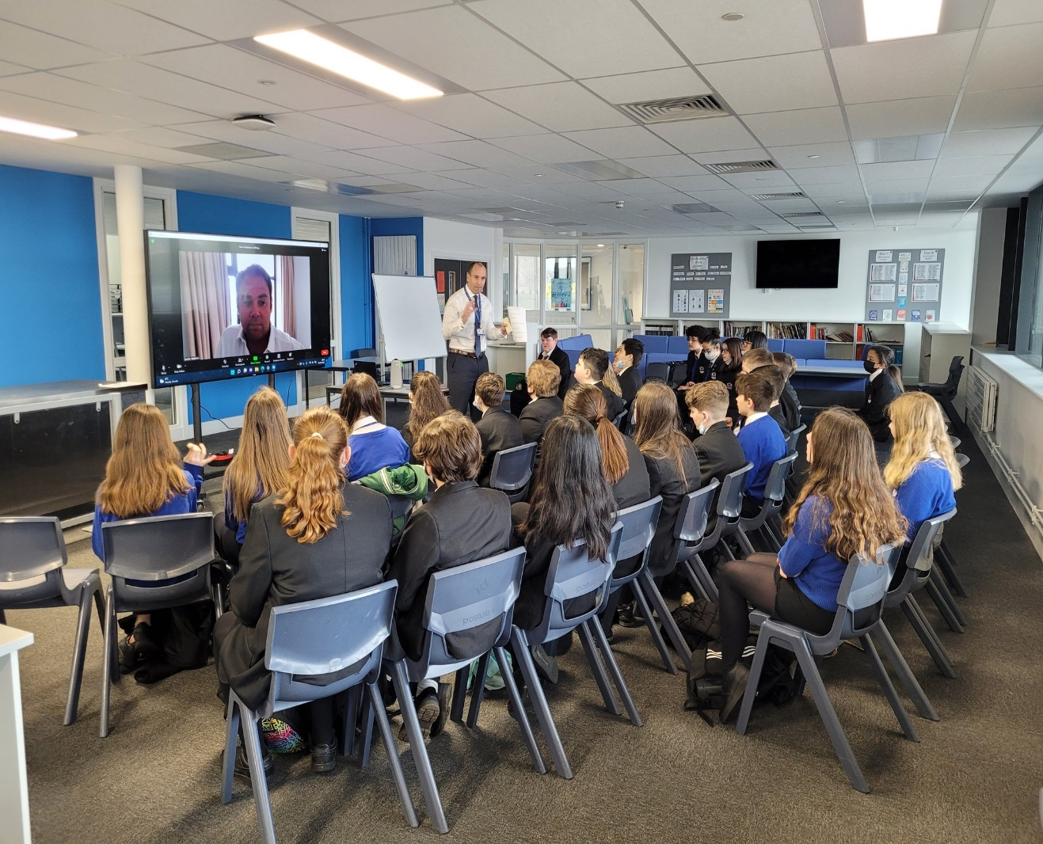
Aspire: A Huge Success
Pupil attendance and engagement
Staff involvement
Also Estyn were VERY impressed!

Slide 4

"An exemplary feature of the schools work is the provision for more able and talented pupils through the ‘Aspire’ programme"
“Aspire helps them (pupils) to develop into ambitious, knowledgeable and inquisitive young people.”
"The innovative ‘Aspire’ programme challenges and inspires more able pupils in Key Stage 3 in areas such as science, literature and economics."

Slide 5
Overall aim of Aspire (Key Stage 3)
“Provide enriched and extended opportunities across the curriculum”
Raising aspirations, expectations and standards in KS3.
To provide a foundation of positive attitudes to learning
that will benefit pupils in KS4 and in further education.

Slide 6
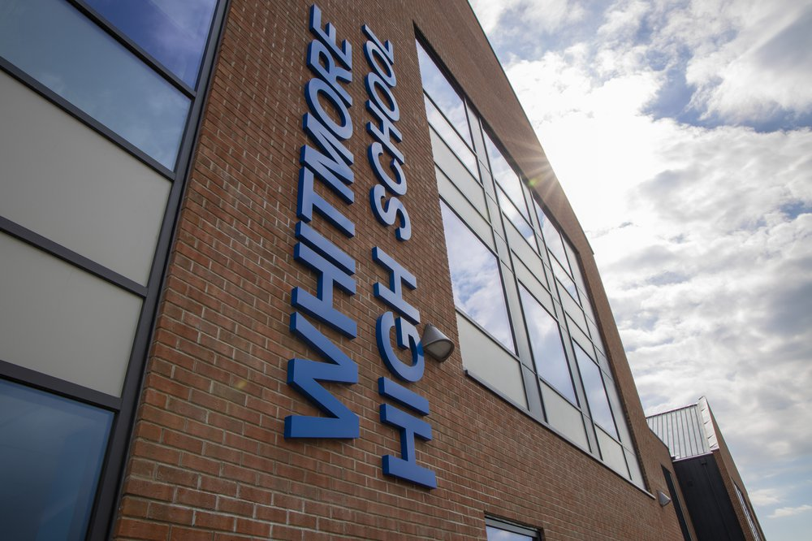
Identification of Aspire Pupils
A variety of information utilised for Aspire selection:
* CATs (Cognitive Ability Tests)
* English, maths & science progress tests
* Welsh national reading & numeracy tests
* Comparative Judgement writing tests
* Accelerated Reader Star reading tests
* Ongoing classroom performance

Slide 7
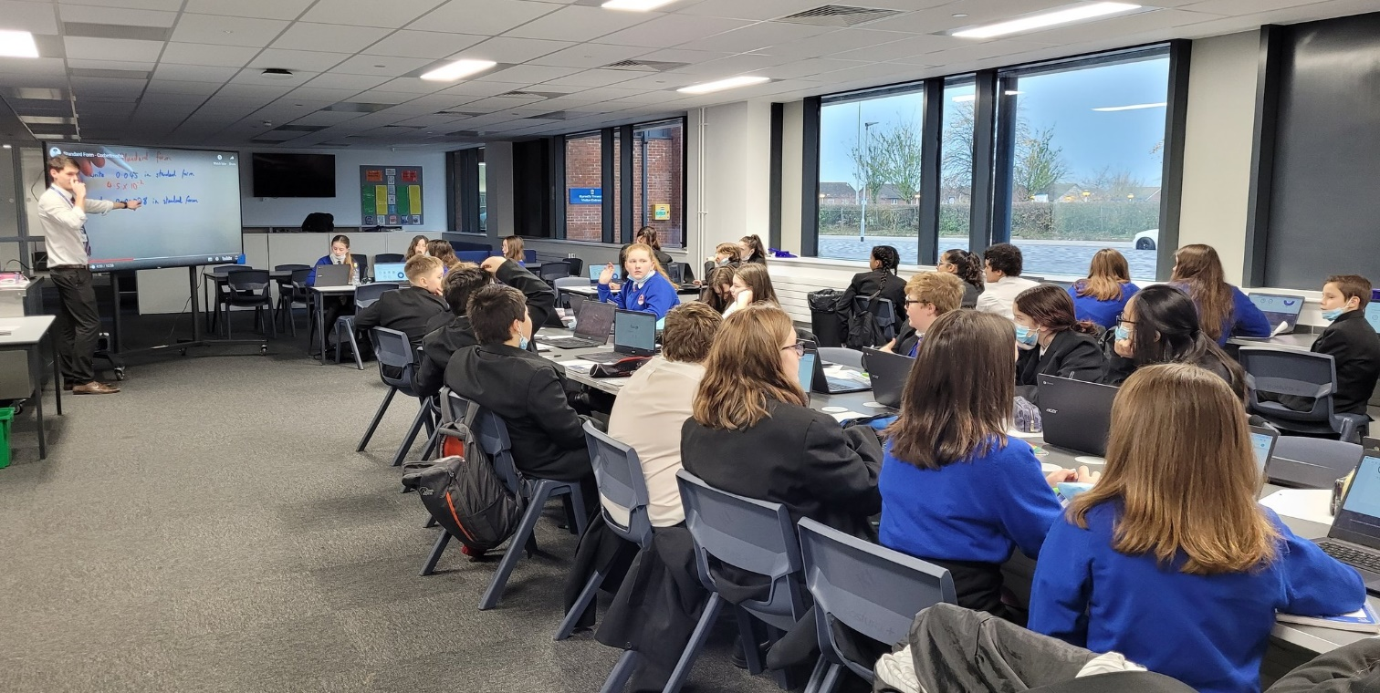
Benefits of being part of Aspire
Academic Benefits
Extra support and challenge from subject specialist staff.
Sessions focussed on ensuring solid foundations are laid for increased levels of difficulty.
Extending curriculum content.

Slide 8
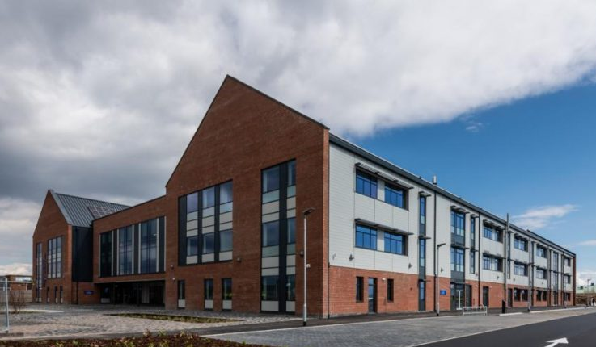
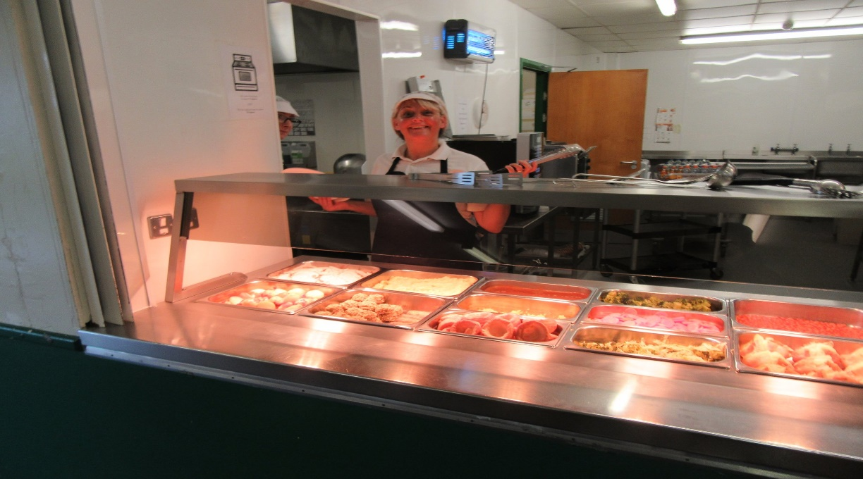
Benefits of being part of Aspire
Other Benefits
Visits and guest speakers
Pupils will be able to enter the school building from 7.45am
A free Breakfast will be available until 7.55am.*

Slide 9
Impact of Aspire
The programme focuses pupils on:
Striving for excellence in academic development.
Increasing their motivation to be the best version of themselves.
Understanding that hard work and resilience will be rewarded.
Understanding that delayed gratification is a concept to be valued.

Slide 10
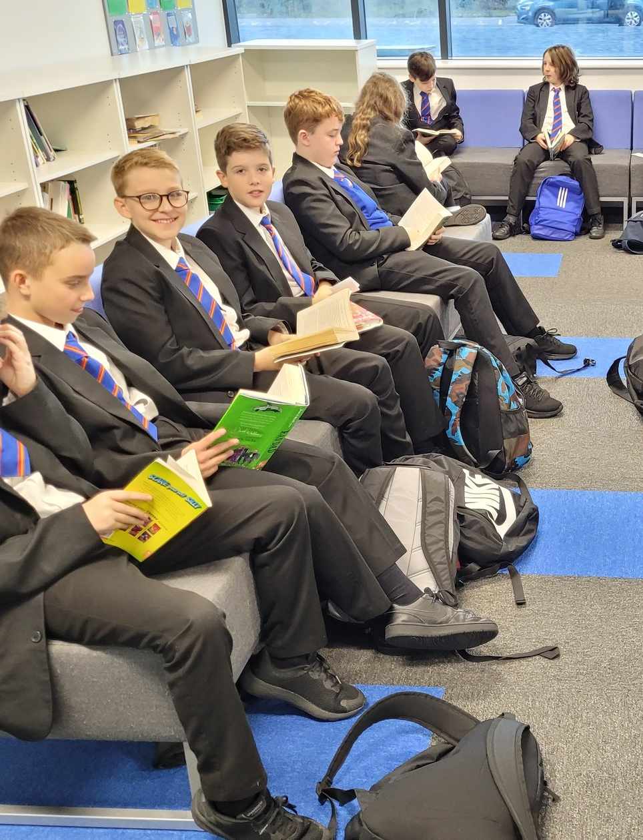
Impact of ASPIRE
Aspire aims to help pupils:
Become role models for their peers.
Develop confidence in different areas of the curriculum.
Fully understand and uphold the Whitmore High School Values:
  Resilience
  Hard work
  Respect
  Responsibility

Slide 11
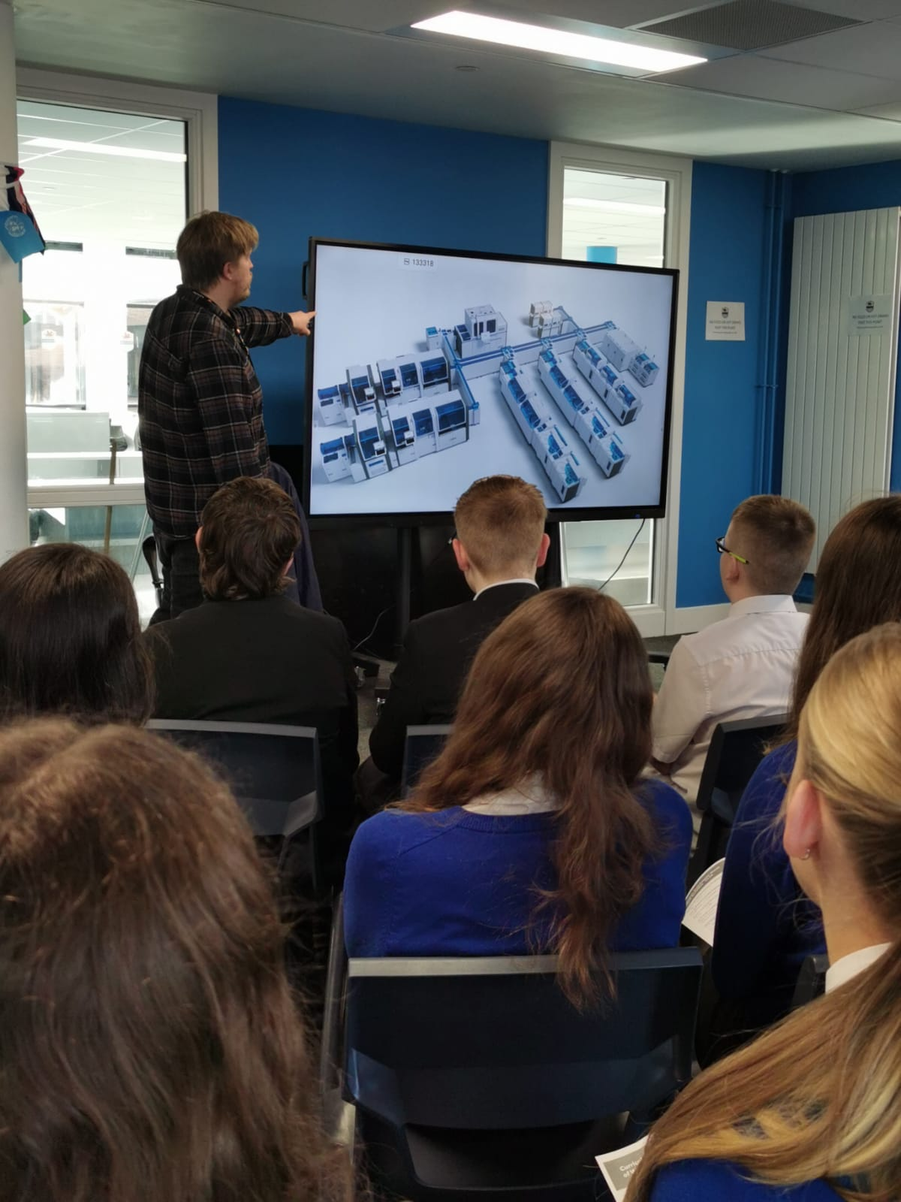
Year 8 Aspire - Maths
Provision will be split into 2 groups
Group 1: Monday 8.00am-8.30am*
Group 2: Thursday 8.00am-8.30am*
Led by subject specialist
Miss Williams (Maths dept)
*Doors open at 7.45am
Sessions will run from w/b 9th October

Slide 12

Aspire Maths
During this term, we aim to further develop pupils number skills. They will be discovering the mathematical ‘next steps’ in their learning.
The topics discussed will be an extension and development of the learning from their timetabled mathematics lessons.
This half term will include BIDMAS with indices, and Venn diagrams for highest common factor, lowest common multiple and prime factor decomposition......GCSE maths!!!!

Slide 13

Aspire Timetable 2023/24
You will be provided with a copy of the Aspire timetable, please take time to familiarise yourself with it.

Slide 14
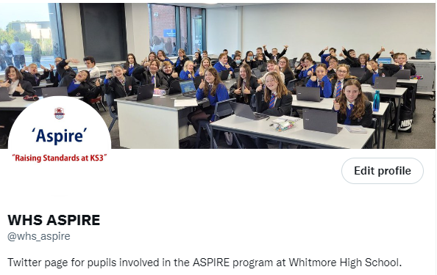
Aspire: Parents and Guardians
Support
Encourage
Keep up to date:
@whs_aspire

Slide 15
Aspire expectations
Academic Performance
Pupils must have high expectations of themselves at all times
Attendance
Punctuality
Behaviour
Effort
Uniform

Slide 16
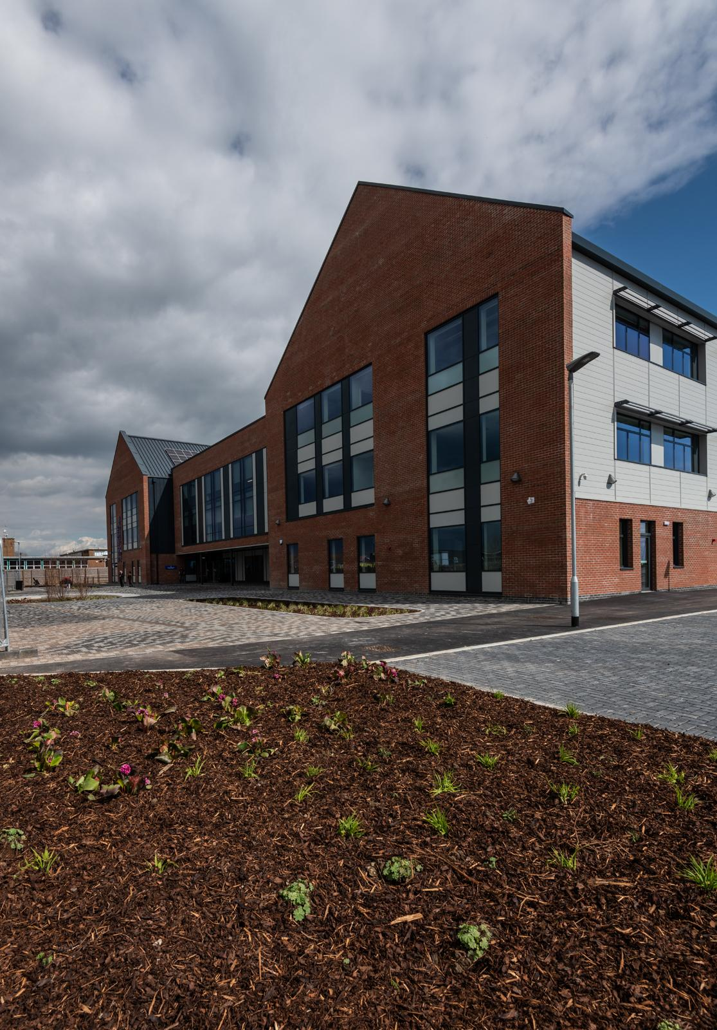
What happens if pupils do not meet expectations of Aspire?
Accepting an invitation to the Aspire programme is not compulsory.
An acceptance of the invitation means a commitment to being part of the Aspire group and benefitting from it.
We have set high expectations and if they are not maintained, we will support pupils to help them.
However, consistently falling below the standards set will lead to other pupils being given the opportunity to be part of Aspire in their place.

Slide 17
Aspire: What happens next?
If you would like to take advantage of this opportunity for your child, please respond via the Google form (links are below) by 3.00pm Thursday 5th October at the very latest.
Please ensure you complete the correct form:
Year 8 Maths Group 1:
Year 8 Aspire Maths Group 1 Invitation 2023/24 - Google Forms
Year 8 Maths Group 2:
Year 8 Aspire Maths Group 2 Invitation 2023/24 - Google Forms
Responses after this time means a place in Aspire cannot be guaranteed.
If you have issues with accessing this link, copy and paste it into your browser or respond via email to huttonm6@hwbcymru.net with the subject as:
Child’s name – Accept/ Decline ie Mark Hutton - Accept

Slide 18
Aspire: What happens next?
Sessions will begin:
Maths (Group 1): Monday 9th October - 8.00am*
Maths (Group 2): Thursday 12th October - 8.00am*
*Doors open at 7.45am

Slide 19
Year 8 Aspire Further Information
Any enquires about the Aspire programme should be directed to:
General questions about the Aspire programme:
Mark Hutton: Academic Enrichment Manager - huttonm6@hwbcymru.net
Questions specifically about the Aspire Maths Programme:
Bethan Williams: Maths - williamb1216@hwbcymru.net
All resources letters and presentations can also be found on the school website under the Aspire tab.

